Slide 1
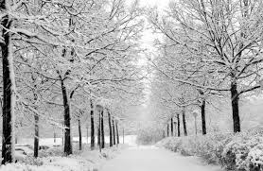
Michael Erickson’s Super Awesome Expert* 2013-2014 Winter Forecast**
*Michael Erickson is not a super awesome expert
**By no means can this be called a “forecast”

Slide 2
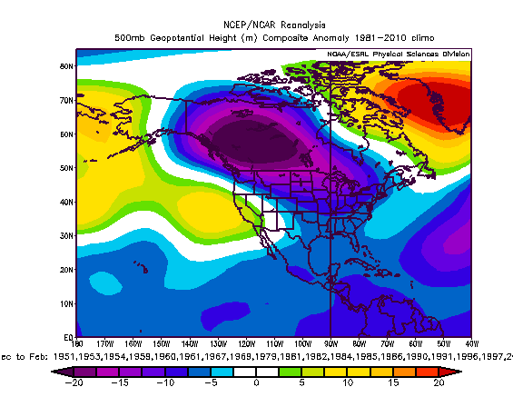
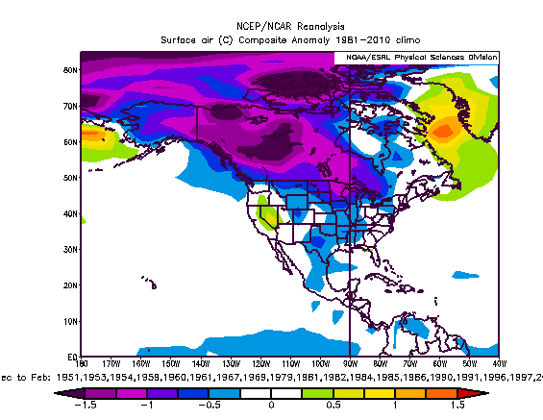
ENSO Neutral Conditions in Sept-Oct
500 hPa Height Anomaly
Surface Temperature Anomaly

Slide 3
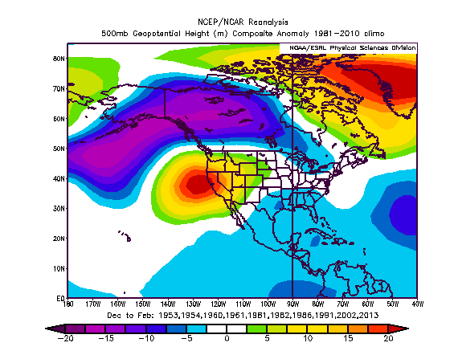
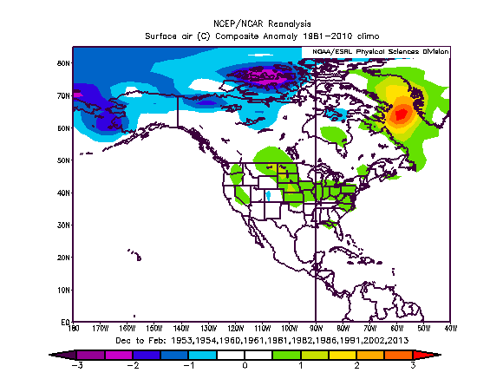
ENSO Neutral Conditions (whole winter)
500 hPa Height Anomaly
Surface Temperature Anomaly

Slide 4
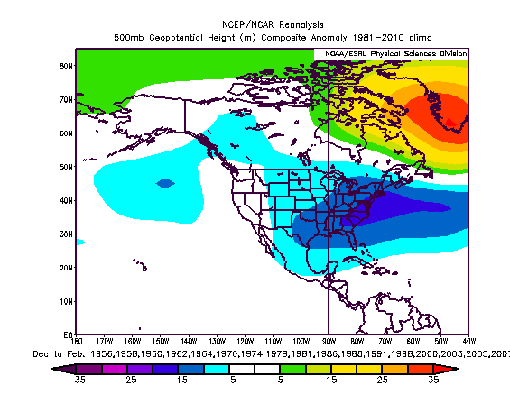
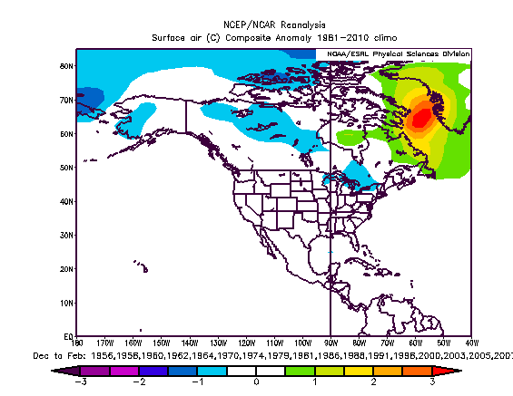
QBO (Positive but dropping)
500 hPa Height Anomaly
Surface Temperature Anomaly

Slide 5
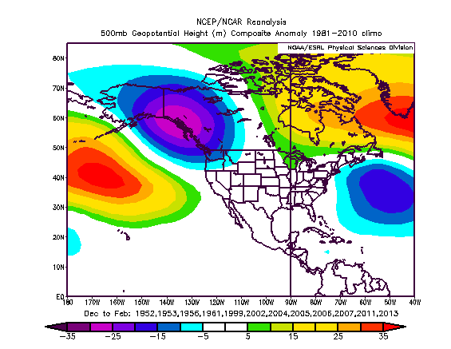
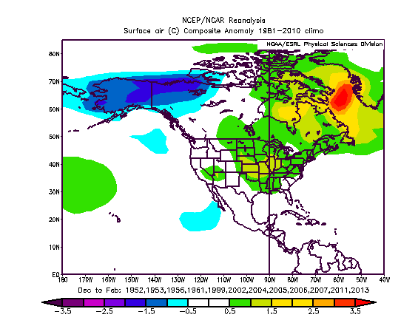
AMO (Positive)
500 hPa Height Anomaly
Surface Temperature Anomaly

Slide 6
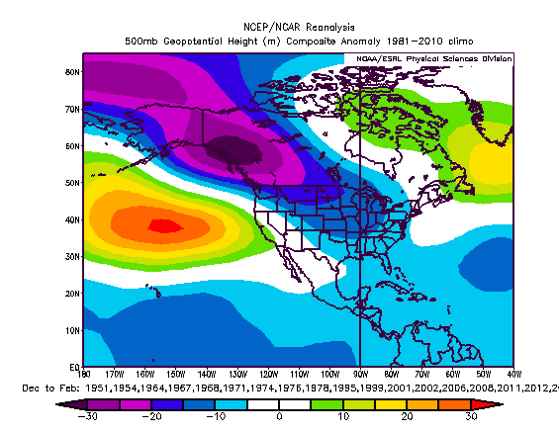
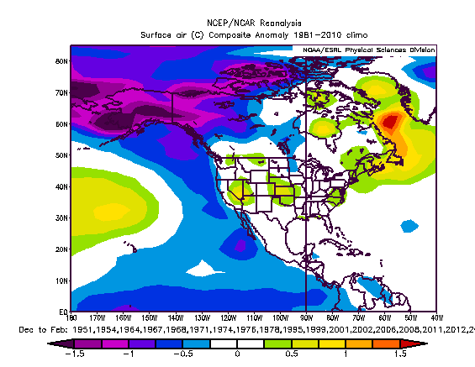
PDO (Negative)
500 hPa Height Anomaly
Surface Temperature Anomaly

Slide 7
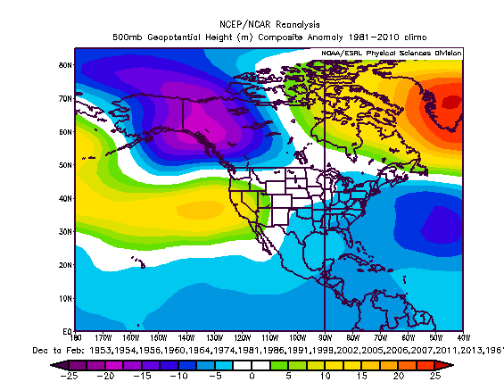
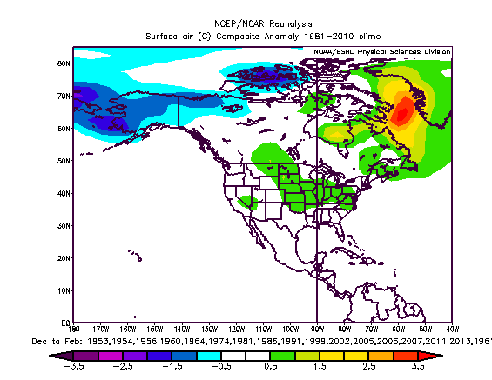
Preferred Years from all Composites
500 hPa Height Anomaly
Surface Temperature Anomaly

Slide 8
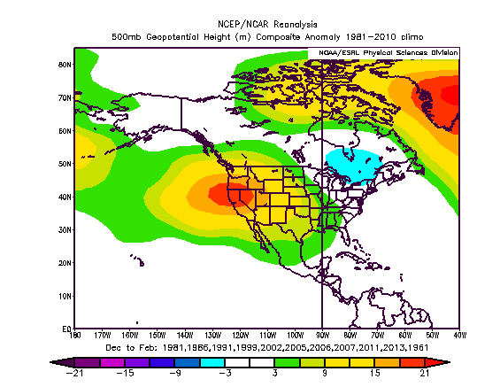
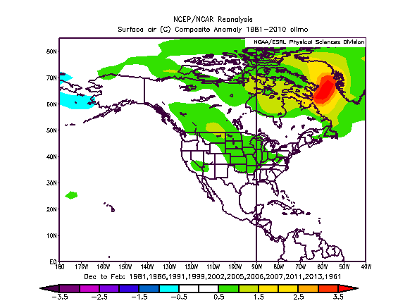
Preferred Years from Composites (recent)
500 hPa Height Anomaly
Surface Temperature Anomaly

Slide 9
Conclusions
There is no signal.
Compositing is a tricky game, maybe I could find a signal by compositing conditional on something else. The trick is keeping that conditional requirement logical.
There is no signal.

Slide 10
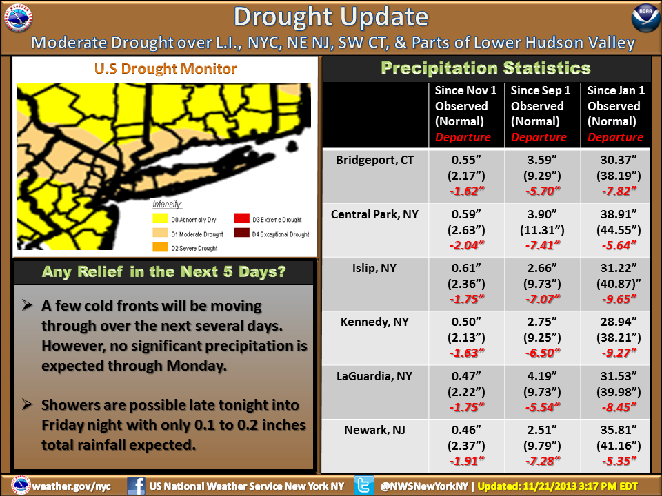
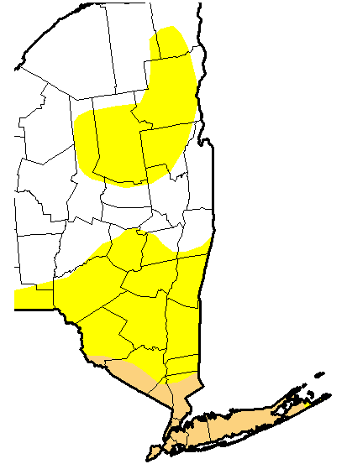
Drought Goodness
There is a saying, “When in drought, forecast drought.” It works well until the drought breaks.

Slide 11
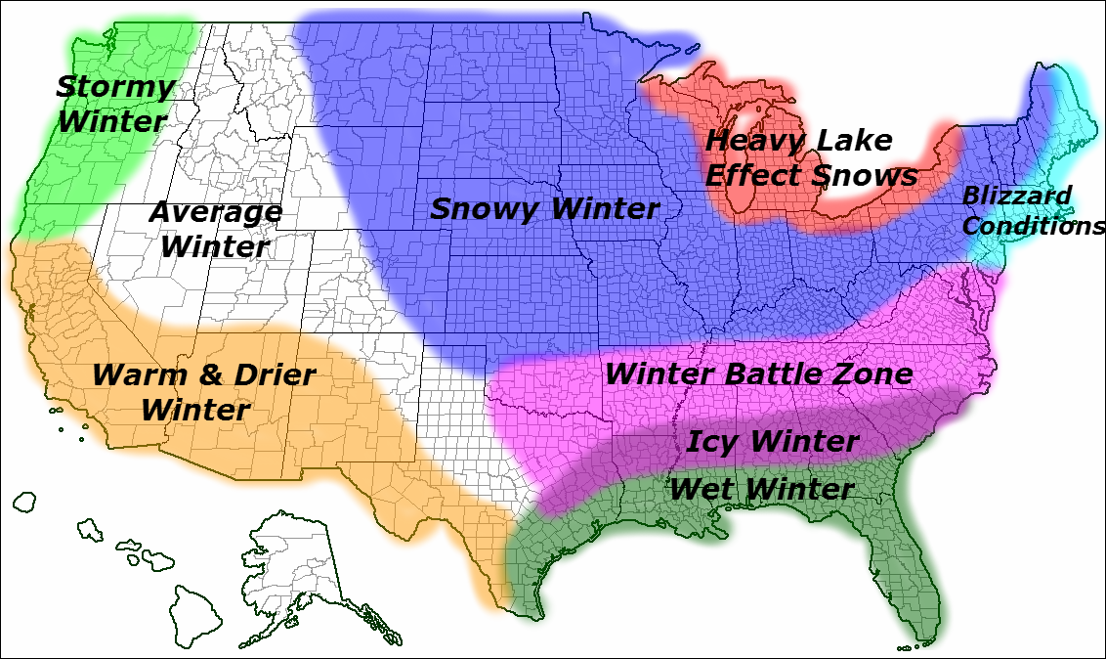
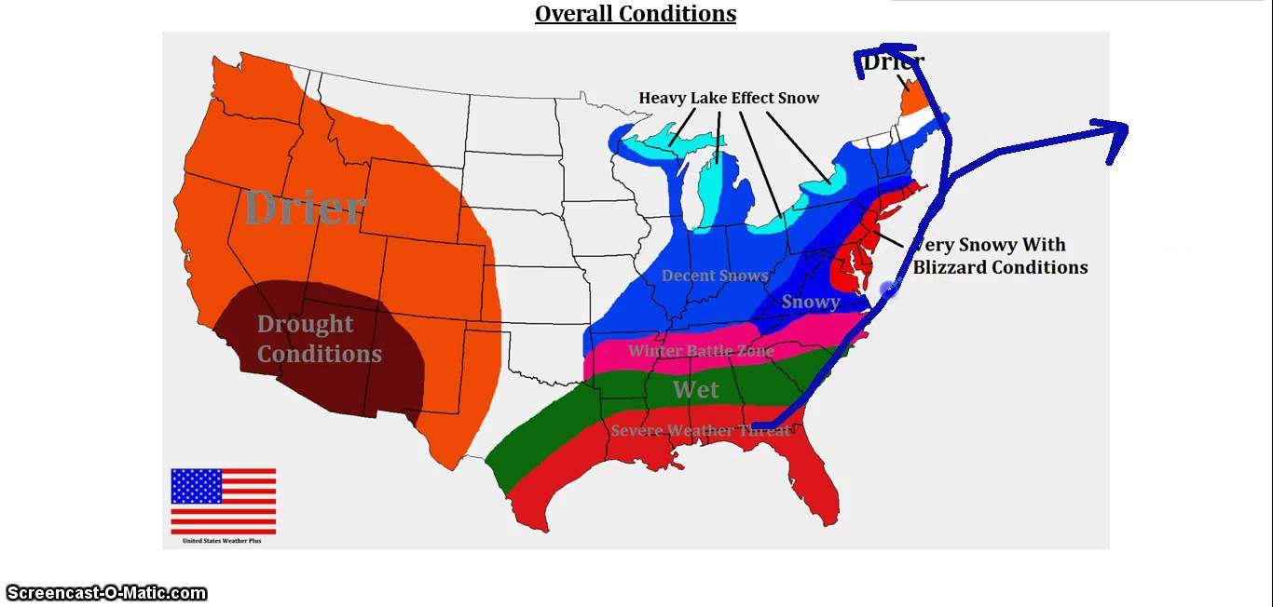
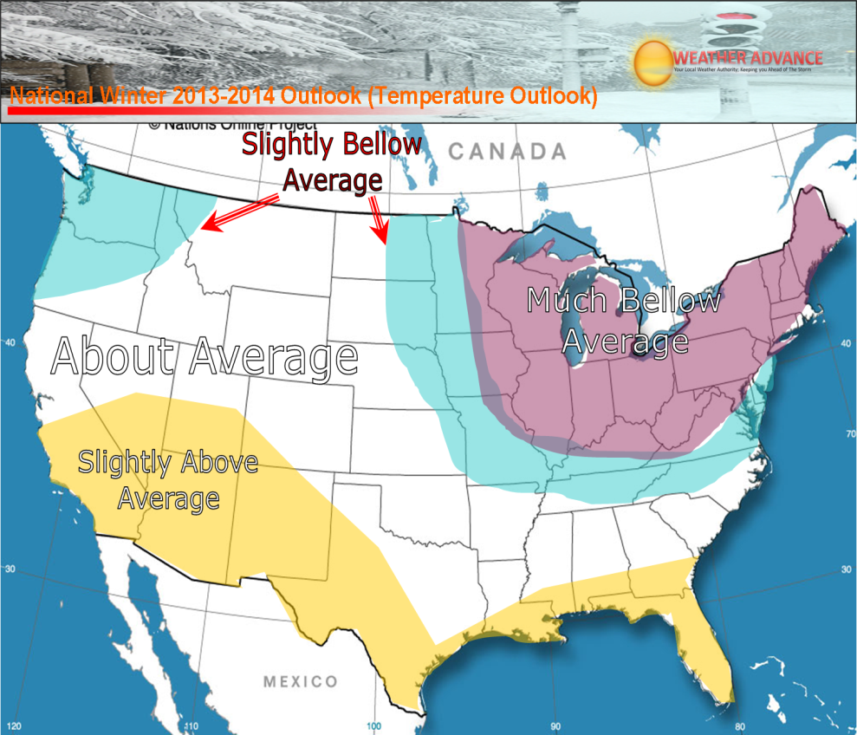
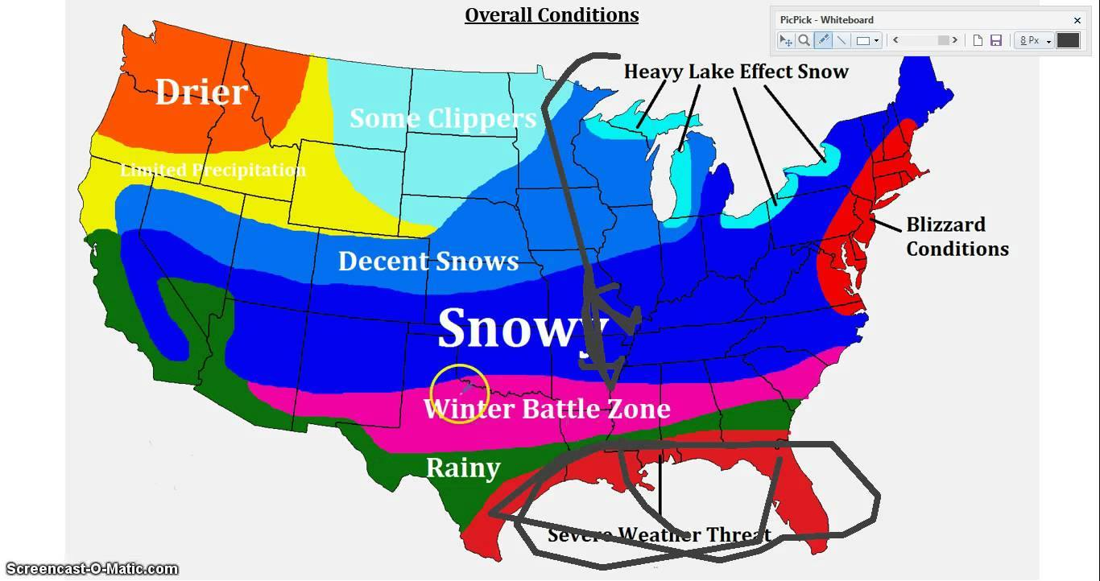
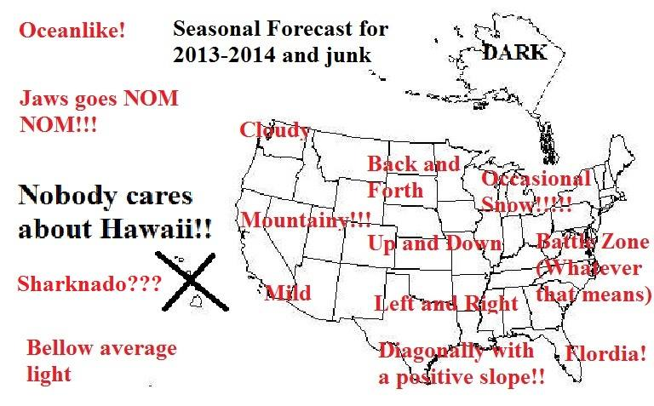
Go With the Weenies Winter Forecast
They are basically the same every year.

Slide 12
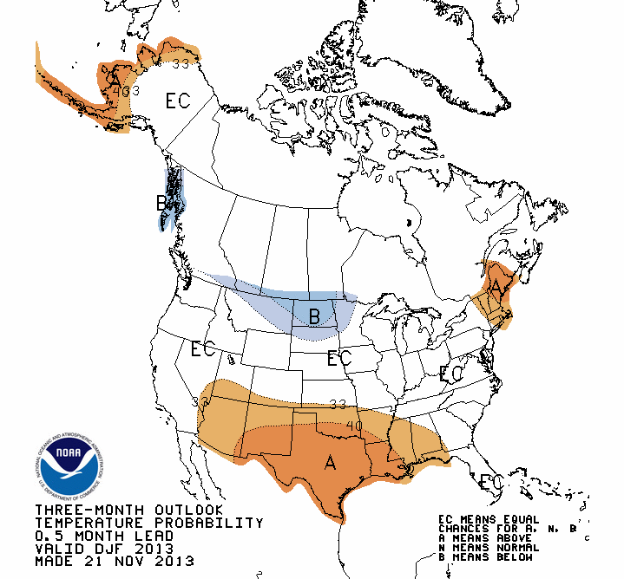
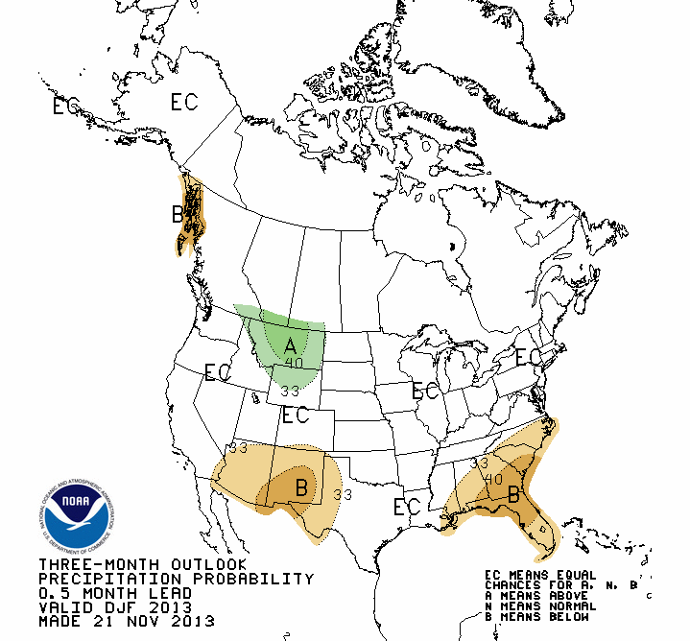
I’d go with the CPC Forecast

