Slide 1
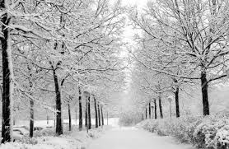
Michael Erickson’s Quasi-awesome Expert* 2014-2015 Winter Forecast**
*Michael Erickson is not a quasi-awesome expert
**By no means can this be called a “forecast”

Slide 2
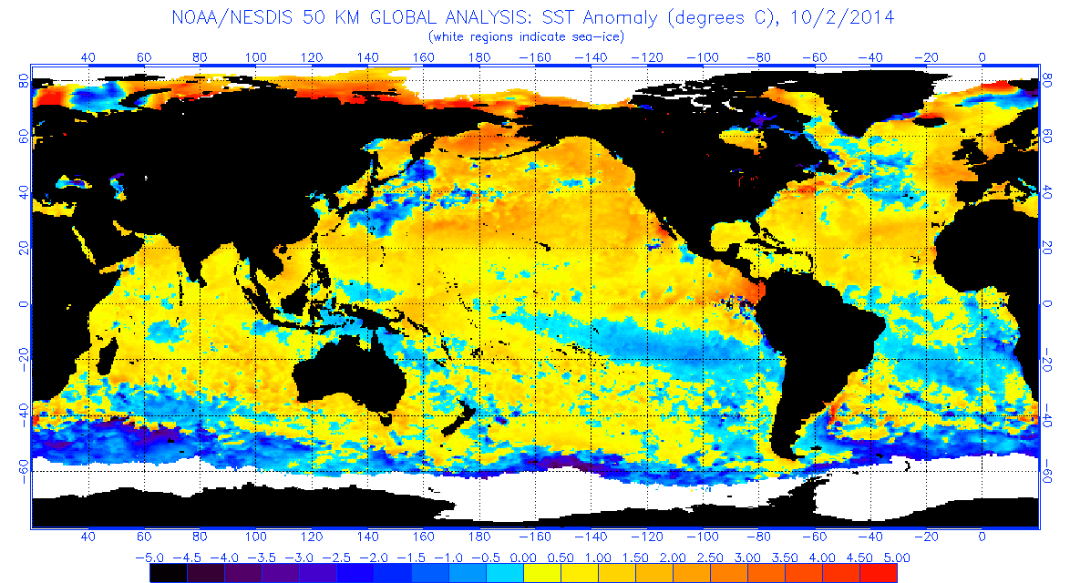
The NH ocean is TOASTY!!

Slide 3
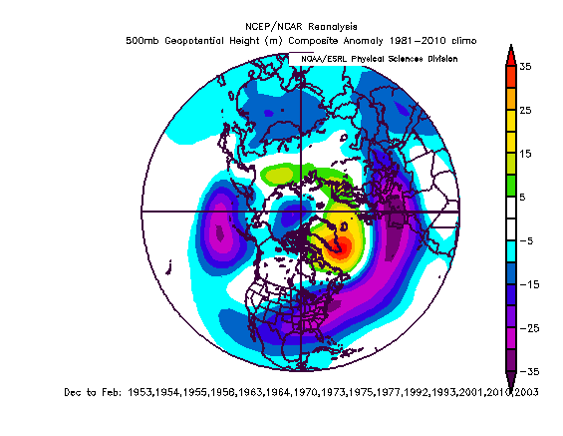
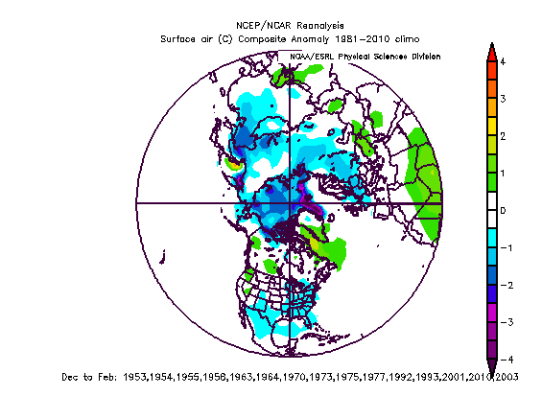
Unsmoothed PDO state going from negative to neutral
500 hPa Height Anomaly
Surface Temperature Anomaly

Slide 4
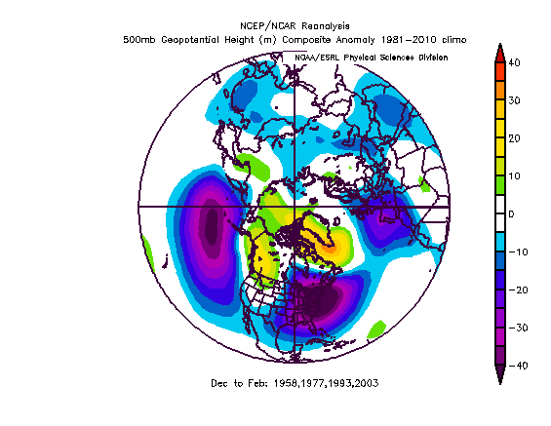
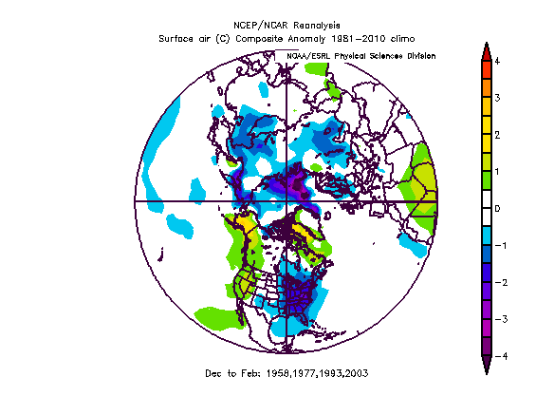
Unsmoothed PDO state – MORE STRICT
500 hPa Height Anomaly
Surface Temperature Anomaly

Slide 5
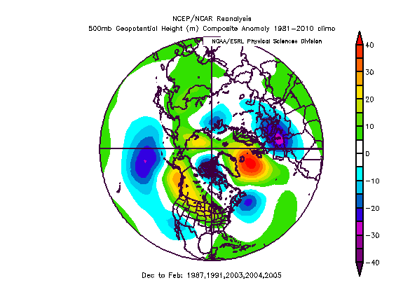
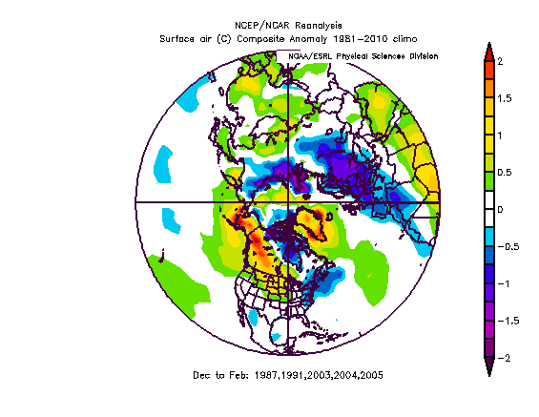
Years With Warm NH SST’s
500 hPa Height Anomaly
Surface Temperature Anomaly

Slide 6
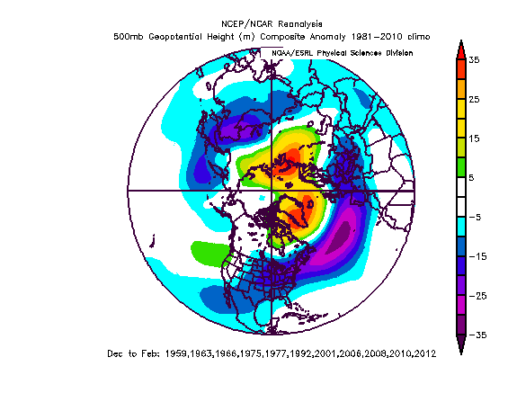
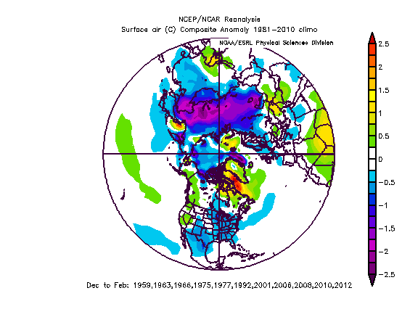
QBO Negative Phase Expected to Peak in the Winter
500 hPa Height Anomaly
Surface Temperature Anomaly

Slide 7
Warm Smoothed AMO
500 hPa Height Anomaly
Surface Temperature Anomaly

Slide 8
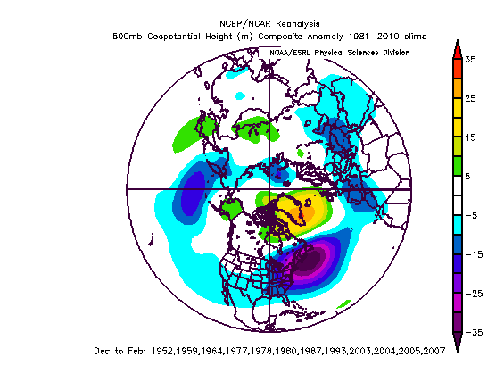
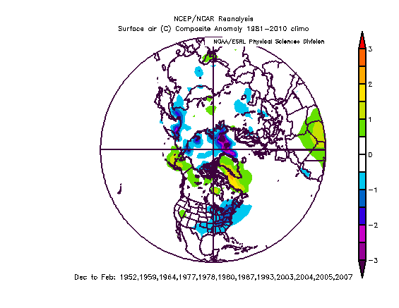
Weak to Moderate MEI
500 hPa Height Anomaly
Surface Temperature Anomaly

Slide 9
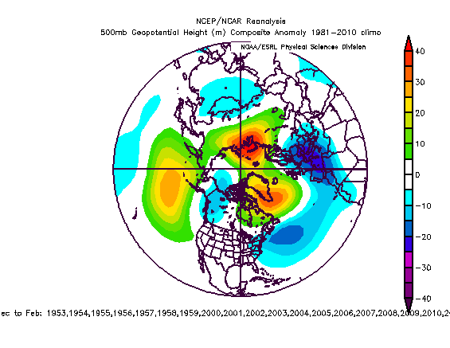
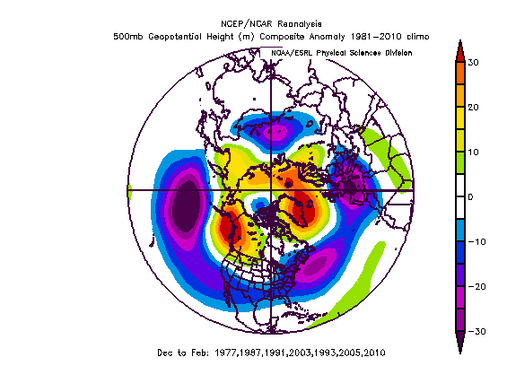
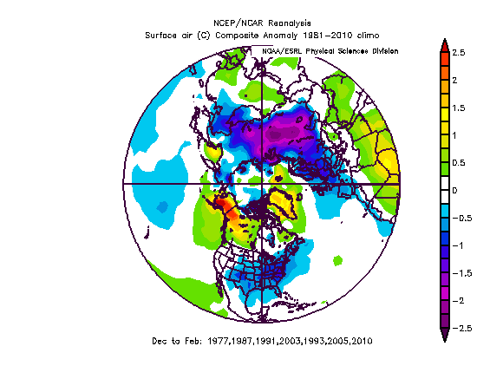
Most Significant “Analog” Years
500 hPa Height Anomaly
Surface Temperature Anomaly

Slide 10
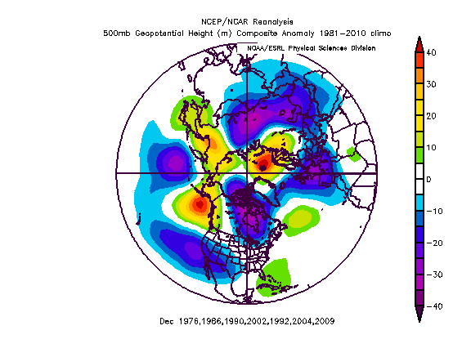
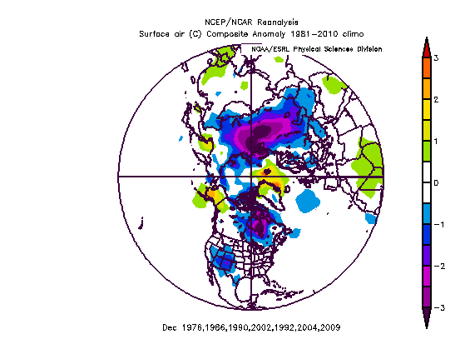
Analog Years By Month - Dec
500 hPa Height Anomaly
Surface Temperature Anomaly

Slide 11
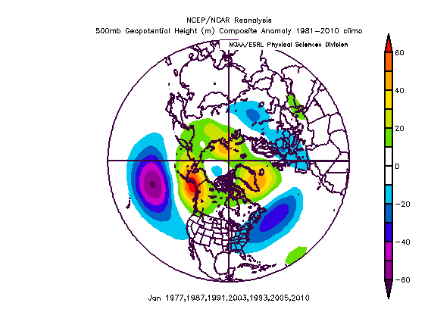
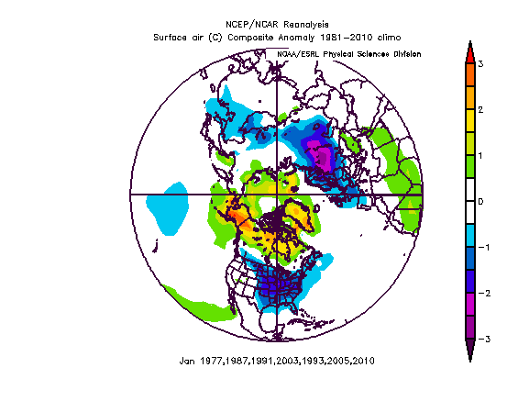
Analog Years By Month - Jan
500 hPa Height Anomaly
Surface Temperature Anomaly

Slide 12
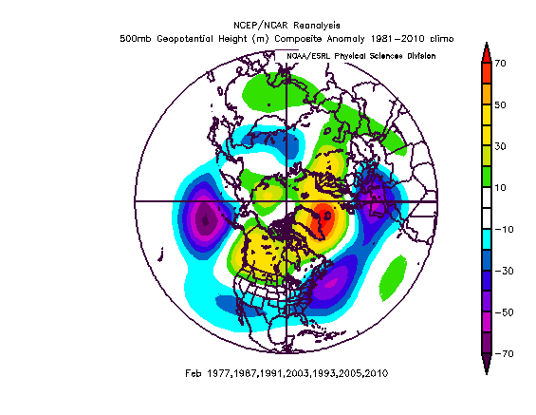
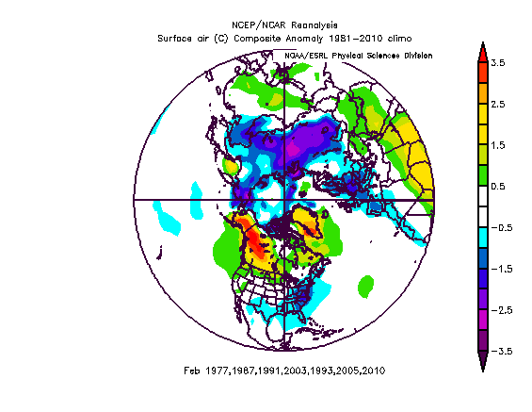
Analog Years By Month - Feb
500 hPa Height Anomaly
Surface Temperature Anomaly

Slide 13
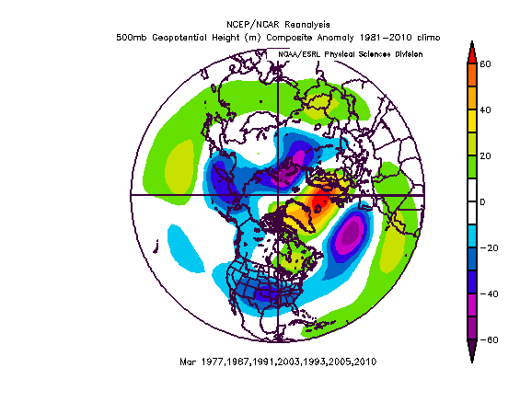
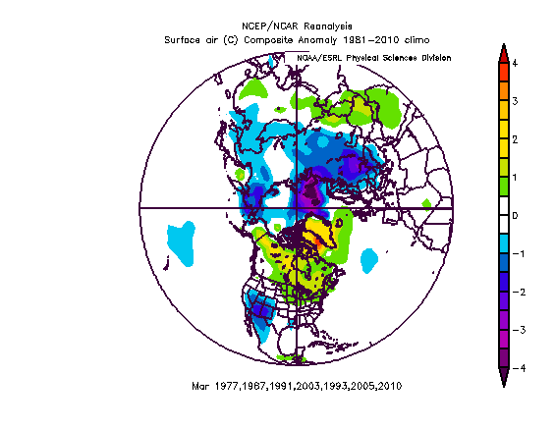
Analog Years By Month - Mar
500 hPa Height Anomaly
Surface Temperature Anomaly

Slide 14
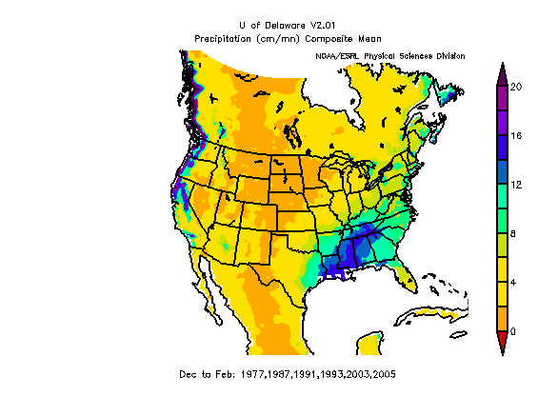
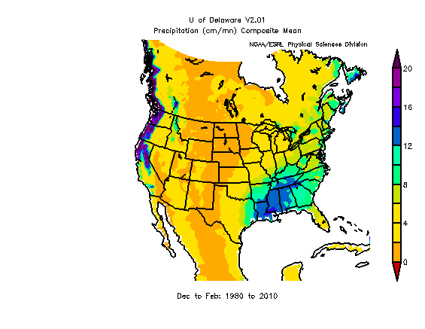
Analog Years - Precipitation
DJF Analog Years
DJF Climo

Slide 15
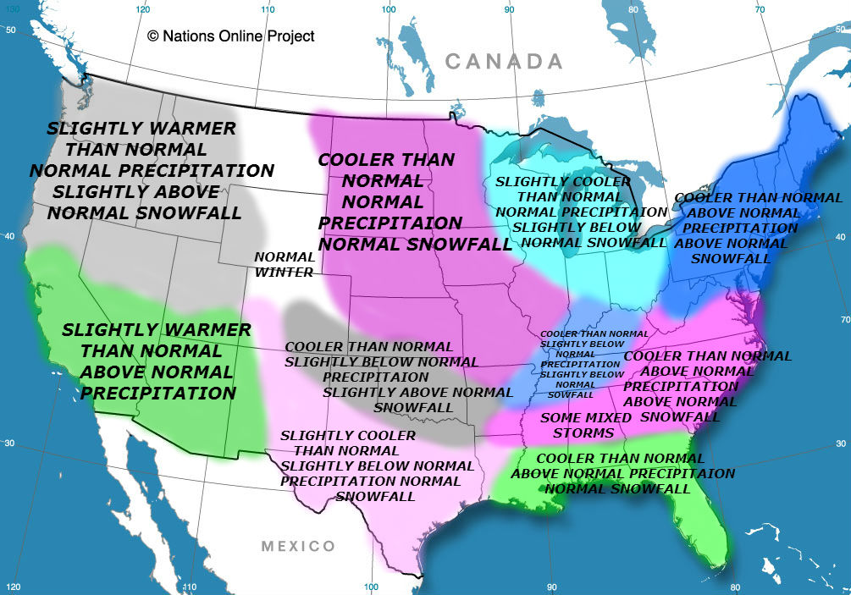
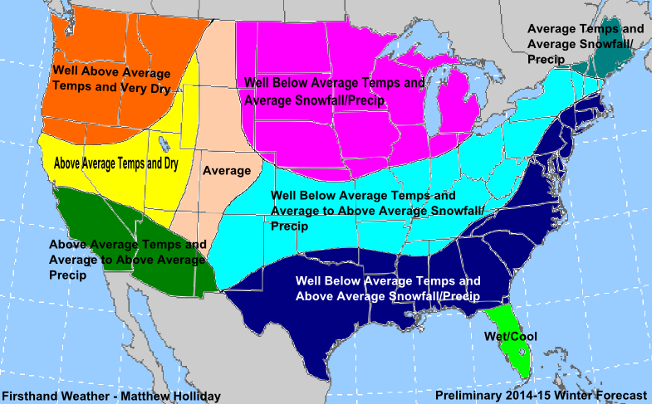
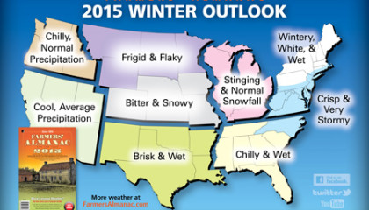
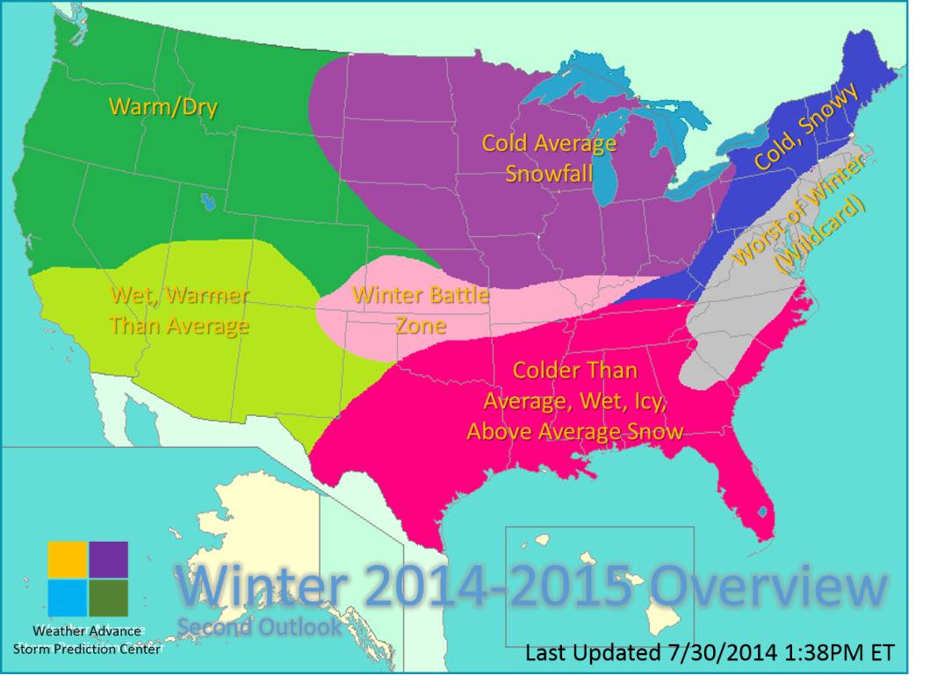
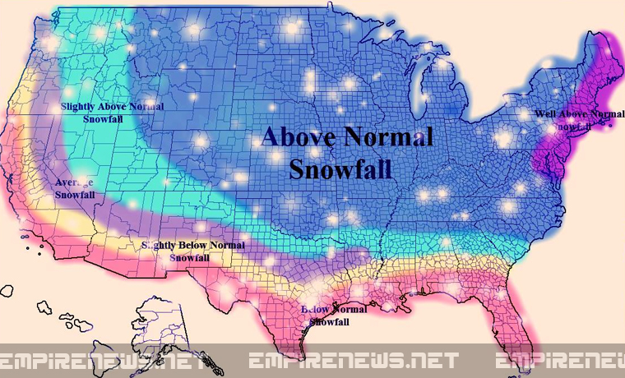
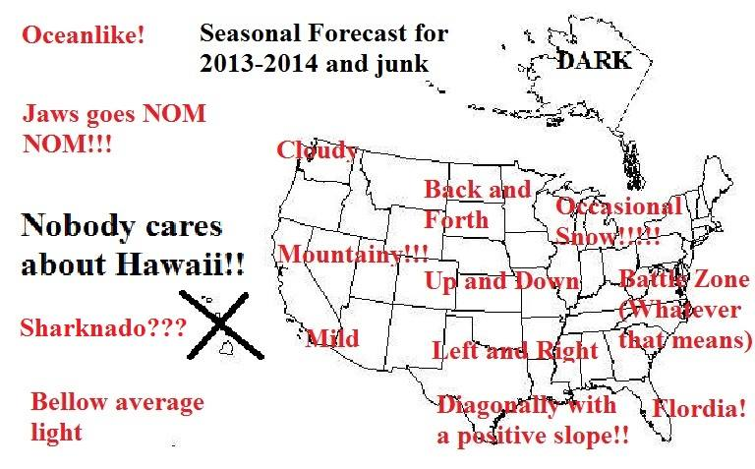
Or…Go With the Weenies Winter Forecast
They are basically the same every year.

Slide 16
Conclusions
There might be a signal.
There is variability in the signal, although subsetting on the most significant analog years produces the same composite.
Compositing is a tricky game, maybe I could find a signal by compositing conditional on something else. The trick is keeping that conditional requirement logical.
If you believe the signal, this winter will be a little chilly, with most of the chill coming in January and February.

Slide 17
Or…Go With the Weenies Winter Forecast
They are basically the same every year.

Slide 18
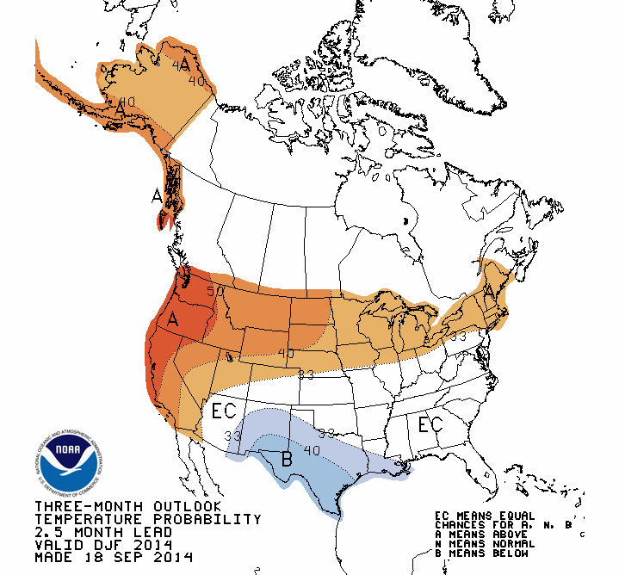
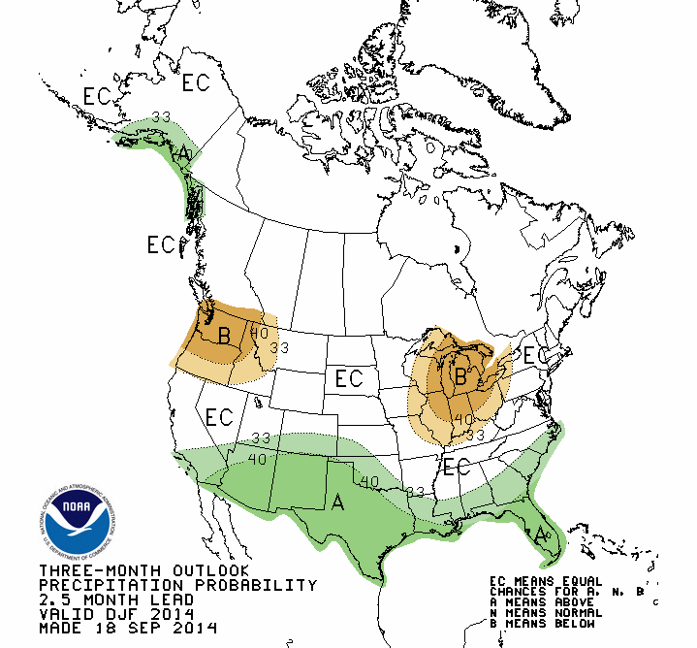
Or…perhaps the CPC
Temperature
Precipitation

