Slide 1
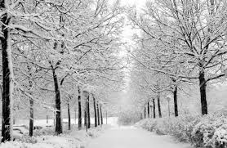
Michael Erickson’s Super Awesome Expert* 2013-2014 Winter Forecast**
A REVIEW***
*Michael Erickson is not a super awesome expert
**By no means can this be called a “forecast”
***This probably shouldn’t be considered a review

Slide 2
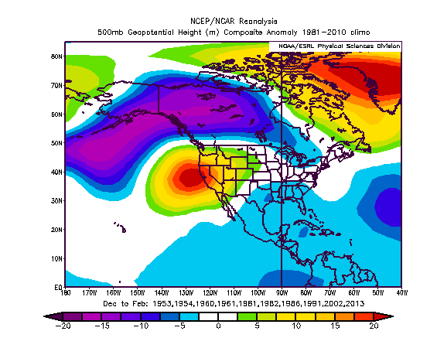
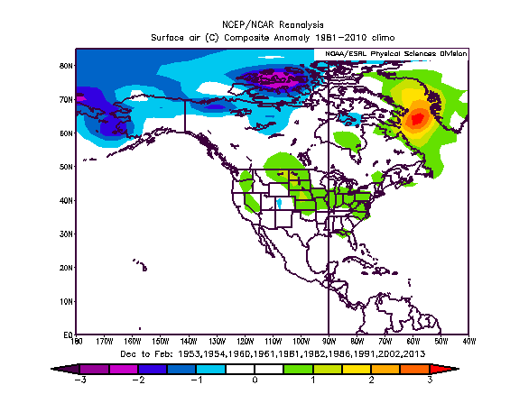
ENSO Neutral Conditions (whole winter)
500 hPa Height Anomaly
Surface Temperature Anomaly

Slide 3
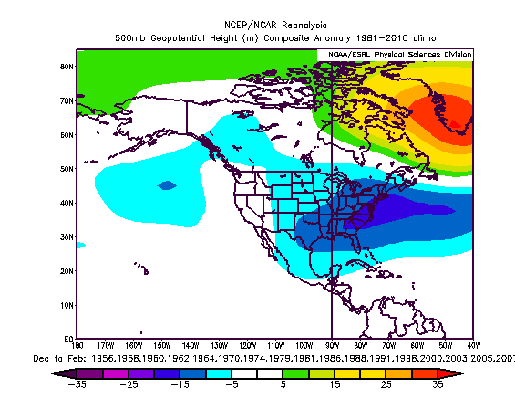
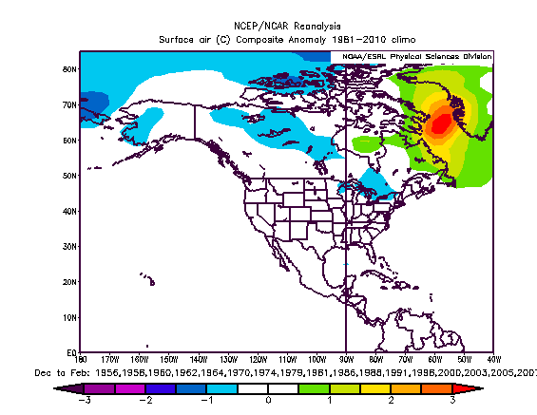
QBO (Positive but dropping)
500 hPa Height Anomaly
Surface Temperature Anomaly

Slide 4
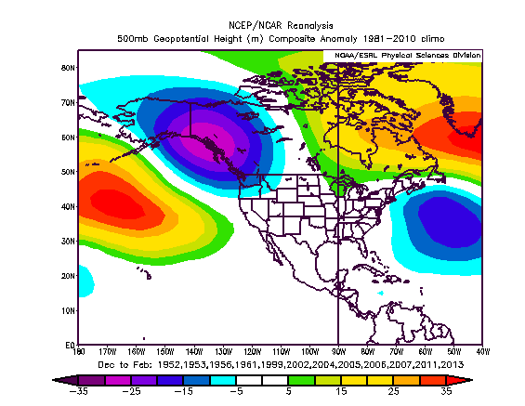
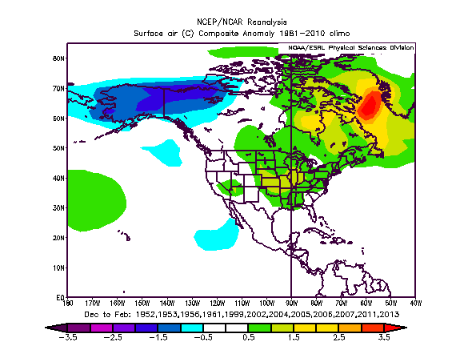
AMO (Positive)
500 hPa Height Anomaly
Surface Temperature Anomaly

Slide 5
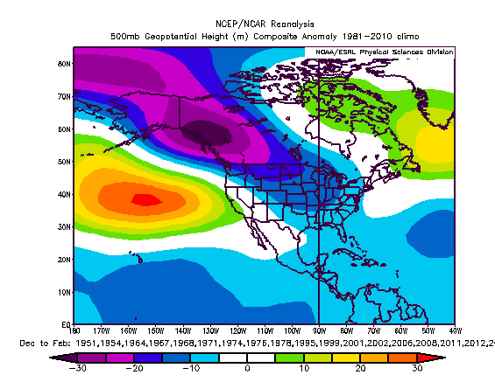
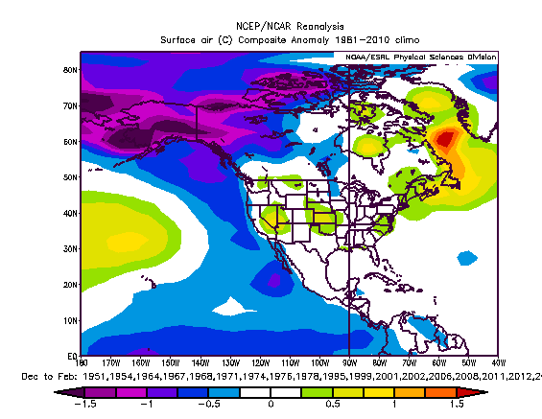
PDO (Negative)
500 hPa Height Anomaly
Surface Temperature Anomaly

Slide 6
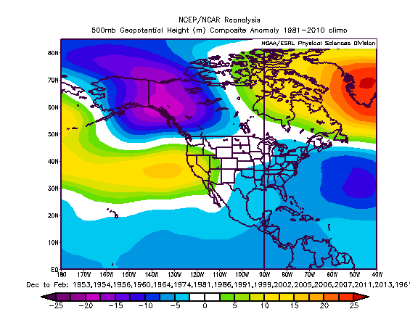
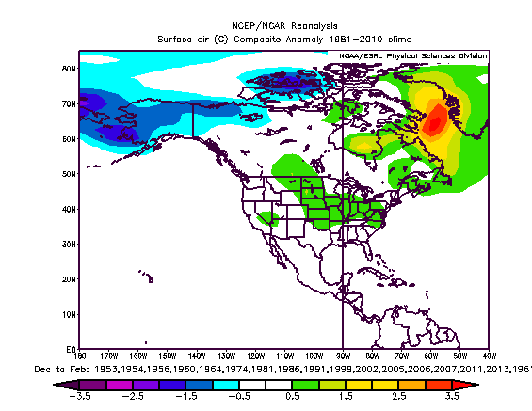
Preferred Years from all Composites
500 hPa Height Anomaly
Surface Temperature Anomaly

Slide 7
Conclusions
There is no signal.
Compositing is a tricky game, maybe I could find a signal by compositing conditional on something else. The trick is keeping that conditional requirement logical.
There is no signal.

Slide 8
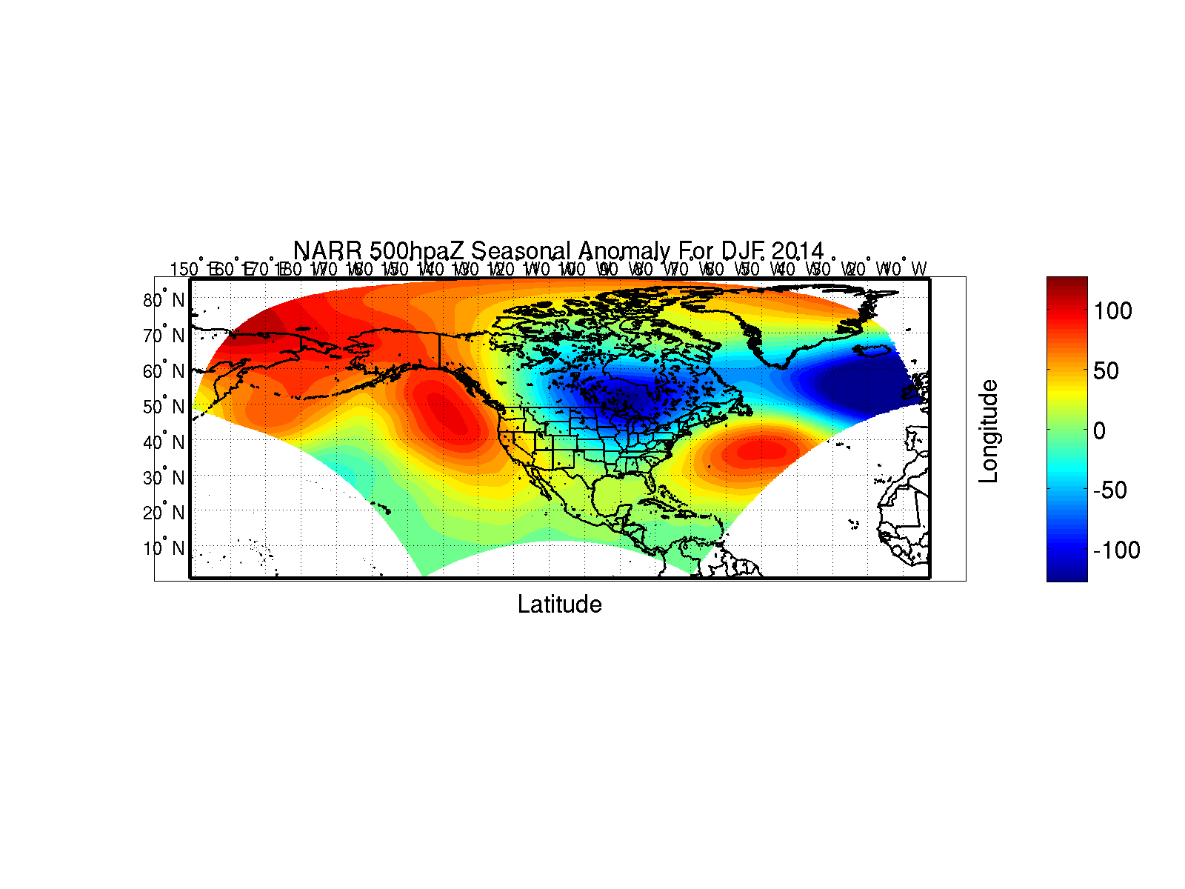
What Happened

Slide 9
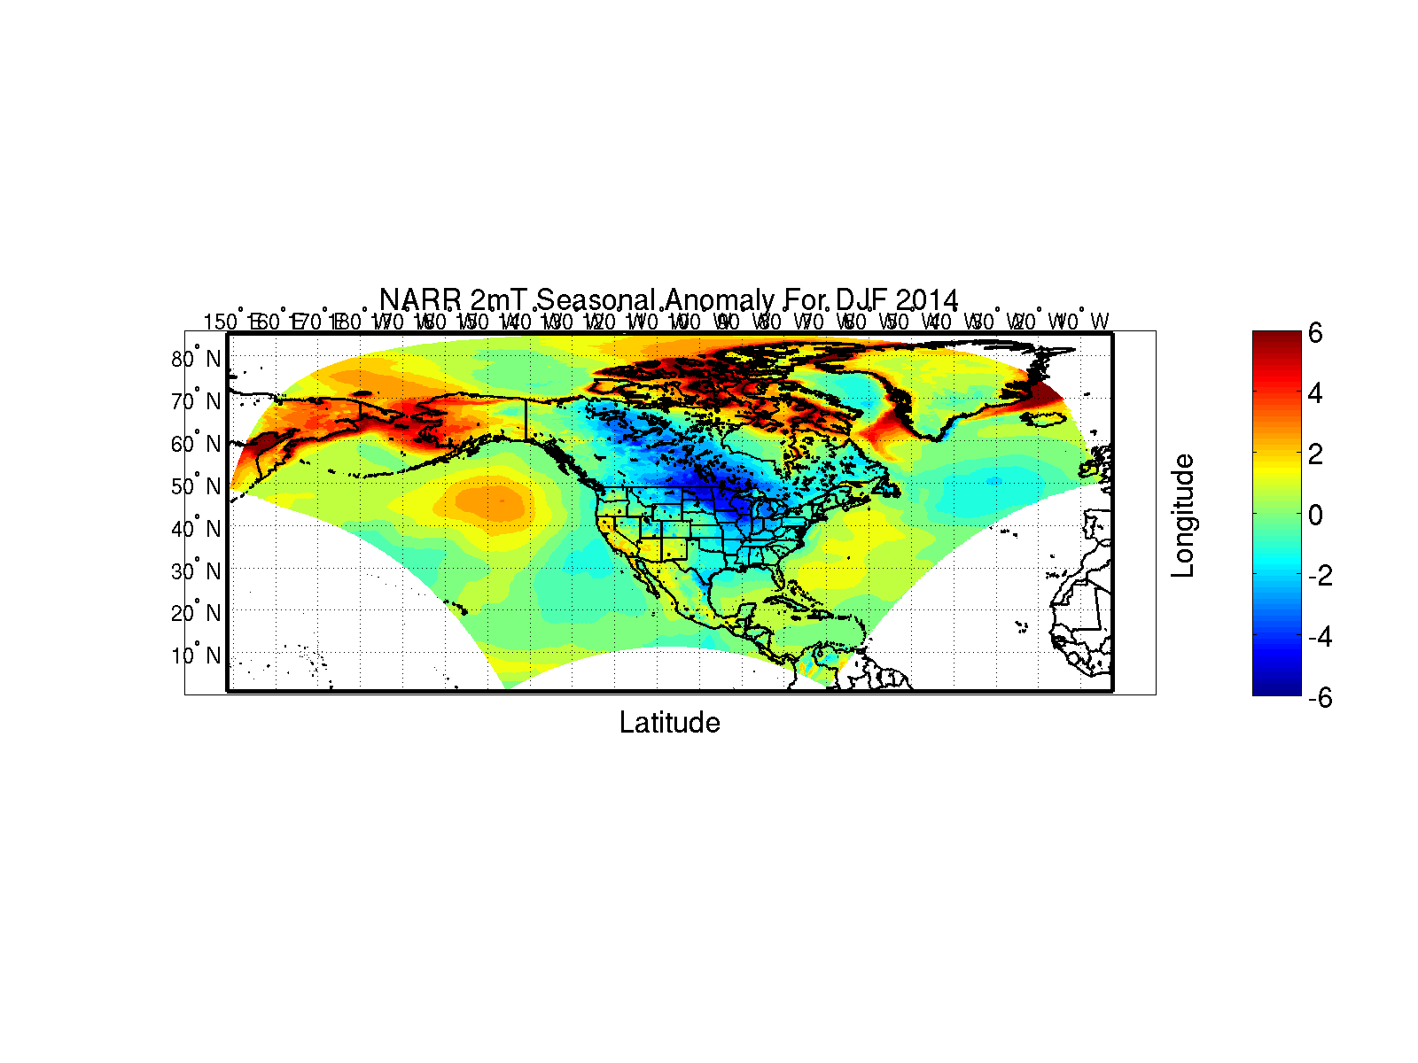
What Happened

Slide 10
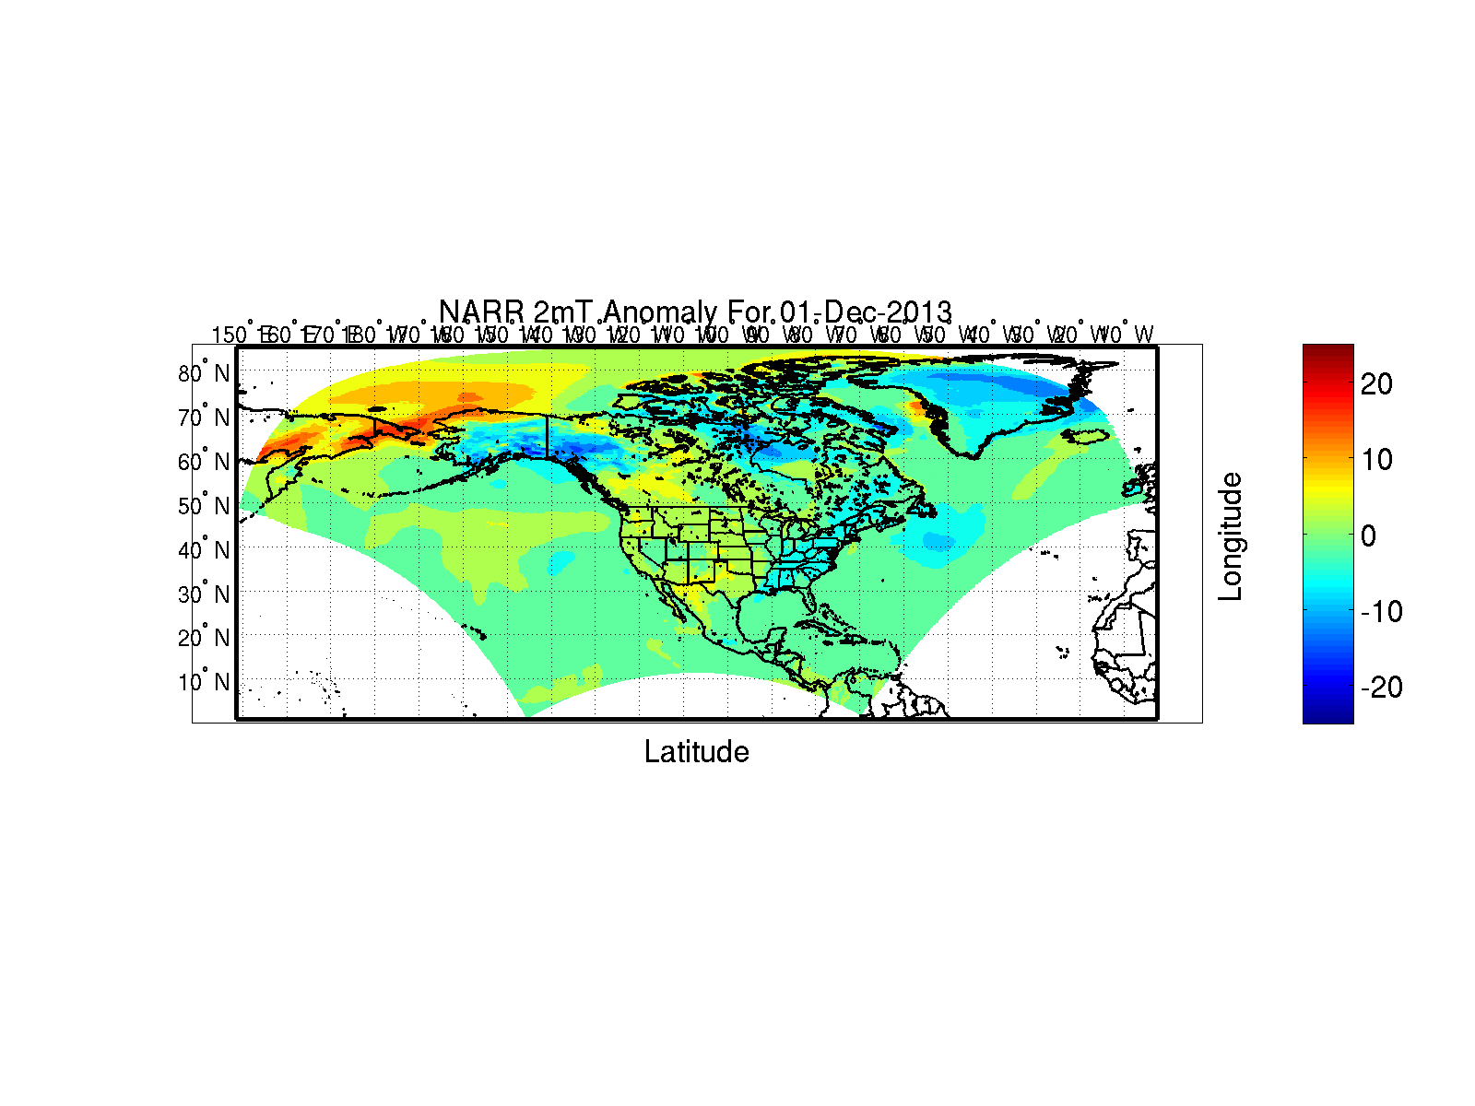
Day by Day

Slide 11
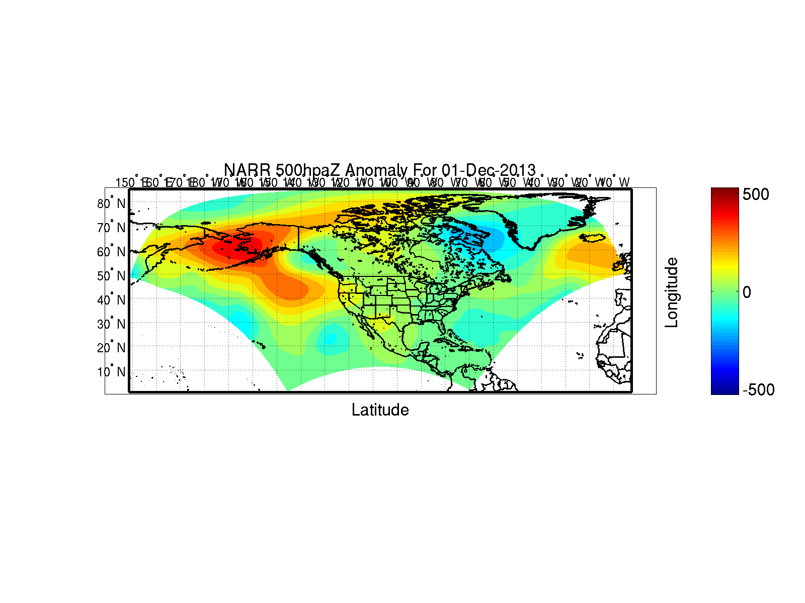
Day by Day

Slide 12
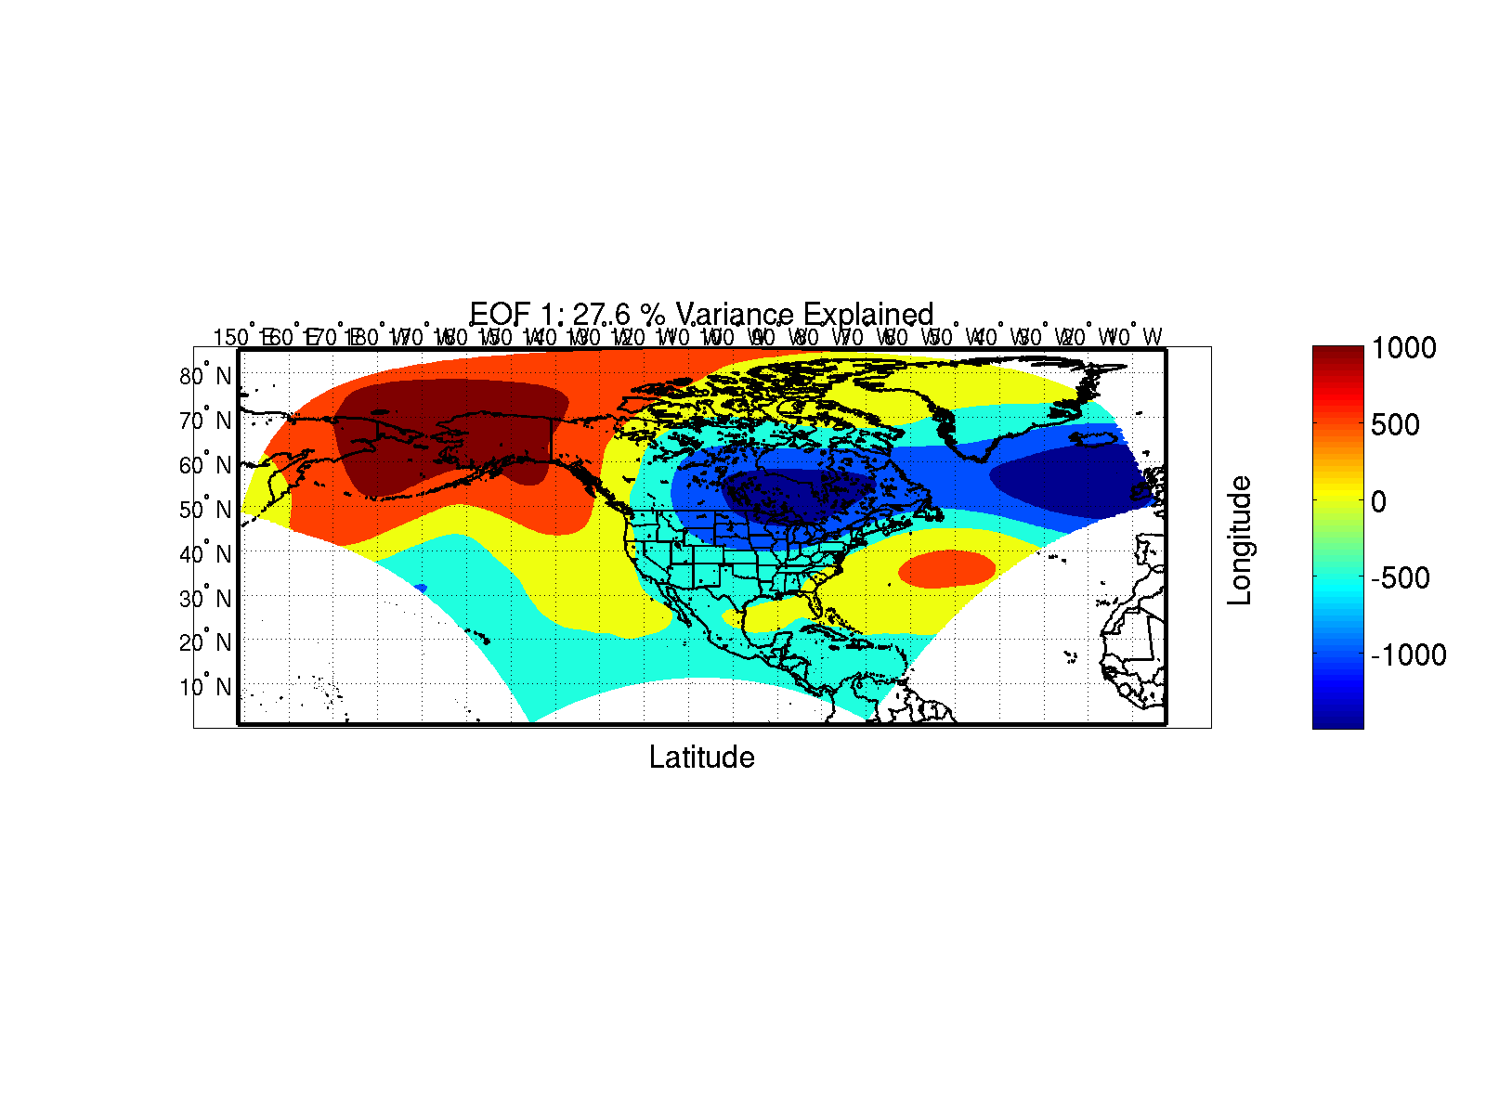
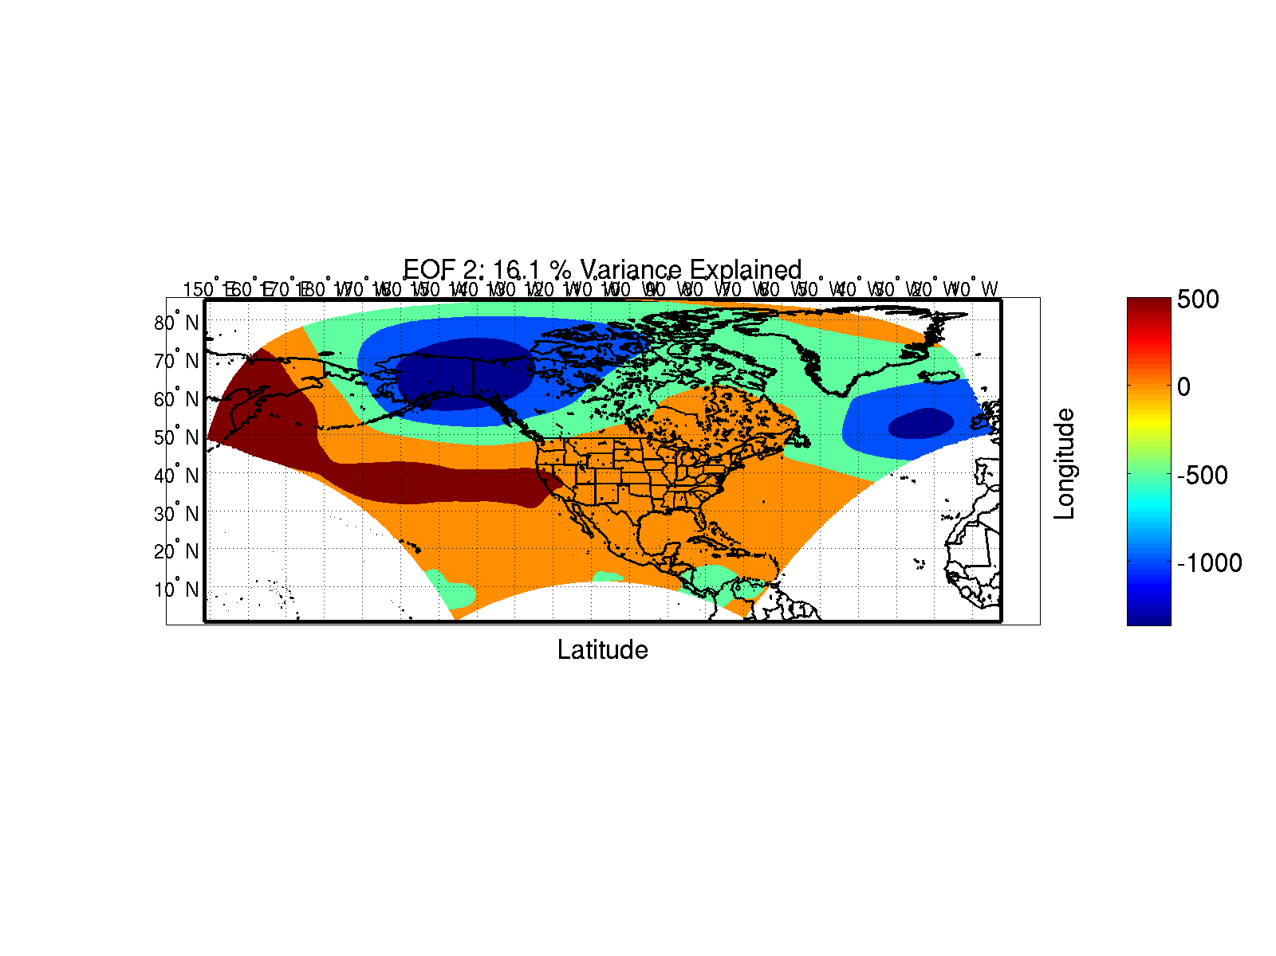
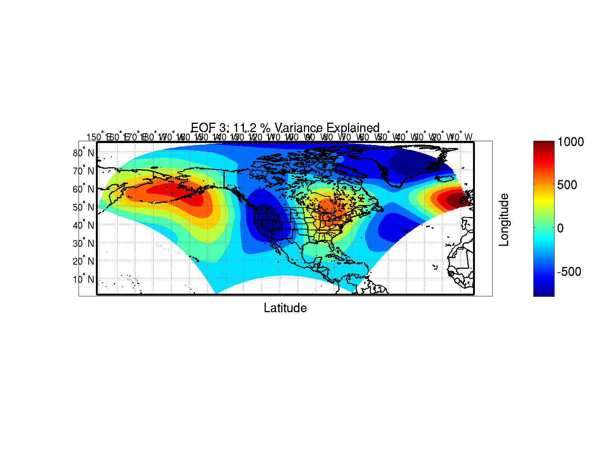
Dominant “Modes” EOF Stuff

Slide 13
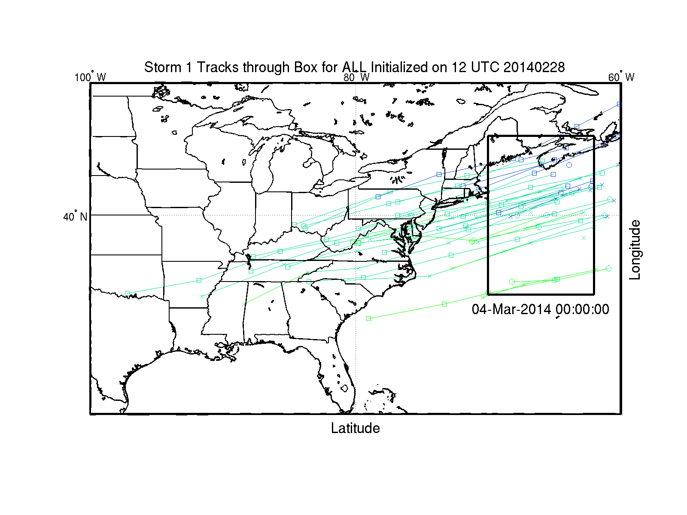
How about that storm last week, huh?

